Slide 1
Introduction to Software Engineering
Dr. Susmita Mandal

Slide 2
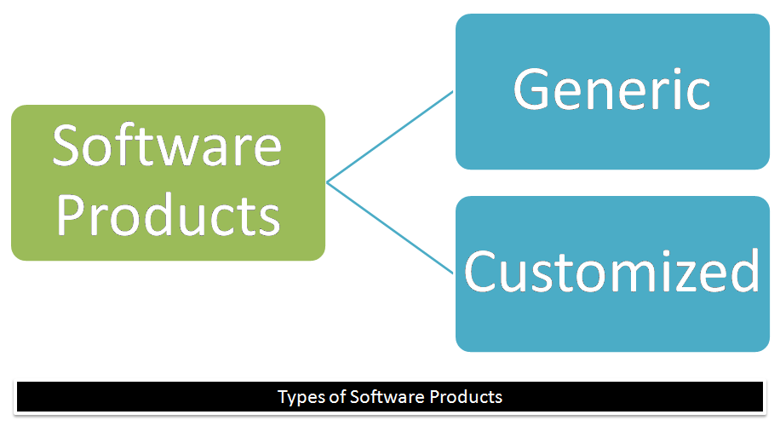
What is software
Software, in its most general sense, is a set of instructions or programs instructing a computer to do specific tasks.
According to textbook Software is:
(1) instructions (computer programs) that when executed provide desired features, function, and performance;
(2) data structures that enable the programs to adequately store and manipulate information
(3) documentation that describes the operation and use of the programs.
Software examples:
Word, Air Control Software, E-mail Software, Browser software,
Mobile banking software, Traffic monitoring software

Slide 3
Defining Software
Software is a logical rather than a physical system element. Therefore, software has characteristics that are considerably different than those of hardware:
Software is developed or engineered, it is not manufactured in the classical sense which has quality problem.
Software doesn't "wear out.” but it deteriorates (due to changes made in the software).
Failure Curve for Hardware
Failure Curves for Software
Hardware has bathtub curve of failure rate ( high failure rate in the beginning, then drop to steady state, Due to change in time the cumulative effects of dust, vibration, abuse increases the failure rate).
Software will undergo change therefore it is likely to error prone, causing the failure rate curve to spike even before achieving a steady state another change may increase the failure rate.

Slide 4
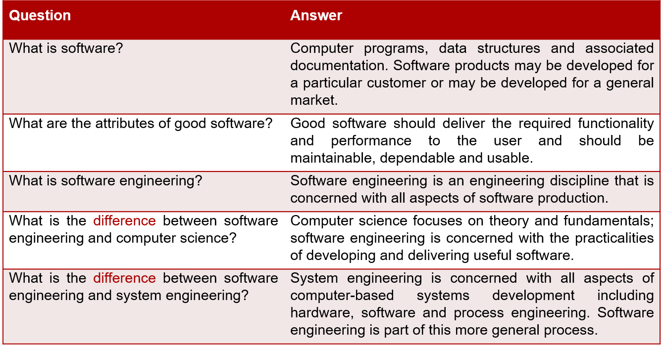
Although the industry is moving toward component-based construction (e.g. standard screws and off-the-shelf integrated circuits), most software continues to be custom-built. Modern reusable components encapsulate data and processing into software parts to be reused by different programs.
E.g. graphical user interface, window, pull-down menus in library etc.

Slide 5
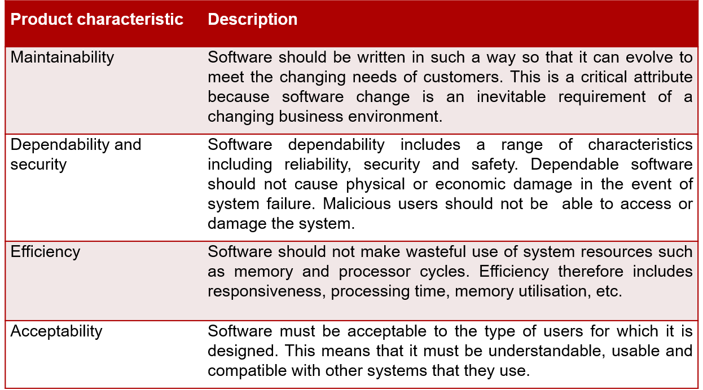
Essential Attributes of good software

Slide 6
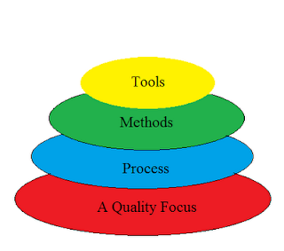
Software Engineering Layers
Software engineering is a layered technology-
Any engineering approach must rest on organizational commitment to quality which fosters a continuous process improvement culture.
Process layer as the foundation layer defines a framework with activities for effective delivery of software engineering technology. Establish the context where products (model, data, report, and forms) are produced, milestone are established, quality is ensured and change is managed.
Method provides technical how-to’s for building software. It encompasses many tasks including communication, requirement analysis, design modeling, program construction, testing and support.
Tools provide automated or semi-automated support for the process and methods.

Slide 7
Software Process
A process is a collection of activities, actions and tasks that are performed when some work product is to be created.
Purpose of process is to deliver software in a timely manner and with sufficient quality to satisfy those who have sponsored its creation and those who will use it.
Process Framework:
Communication: communicate with customer to understand objectives and gather requirements.
Planning: creates a “map” defines the work by describing the tasks, risks and resources, work products and work schedule.
Modeling: Create a “sketch”, what it looks like architecturally, how the constituent parts fit together and other characteristics.
Construction: code generation and the testing.
Deployment: Delivered to the customer who evaluates the products and provides feedback based on the evaluation.

Slide 8
Umbrella Activities
Umbrella activities are applied throughout a software project and help a software team manage and control progress, quality, change, and risk. Typical umbrella activities include:
Software project tracking and control: assess progress against the plan and take actions to maintain the schedule.
Risk management: assesses risks that may affect the outcome and quality.
Software quality assurance: defines and conduct activities to ensure quality.
Technical reviews: assesses work products to uncover and remove errors before going to the next activity.
Measurement: define and collects process, project, and product measures to ensure stakeholder’s needs are met.
Software configuration management: manage the effects of change throughout the software process.
Reusability management: defines criteria for work product reuse and establishes mechanism to achieve reusable components.
Work product preparation and production: create work products such as models, documents, logs, forms and lists.

Slide 9
Software Engineering Practice
Framework activities and umbrella activities establish a skeleton architecture for software engineering work. But how does the practice of software engineering fit in?
George Polya outlines the essence of problem solving*, suggests:
Understand the problem (communication and analysis).
Plan a solution (modeling and software design).
Carry out the plan (code generation).
Examine the result for accuracy (testing and quality assurance).
Notes:
*In depth understanding read section 1.5 from pressman

Slide 10
Case Study-I An Insulin pump control system
1. Understand the problem:
a) The problem with this treatment is that the level of insulin required does not just depend on the blood glucose level but also on the time of the last insulin injection.
b) Irregular checking can lead to very low levels of blood glucose (if there is too much insulin) or very high levels of blood sugar (if there is too little insulin). Low blood glucose can result in temporary brain malfunctioning and, ultimately, unconsciousness and death. However, continual high levels of blood glucose can lead to eye damage, kidney damage, and heart problems.
Insulin pump hardware architecture

Slide 11
Case Study-I
2. Plan a solution:
a) Design of an automated system that can monitor blood sugar levels and deliver an appropriate dose of insulin when required.
b) Blueprint of hardware architecture.
3. Carry out the plan:
a) With advanced miniaturized sensors it is now possible to develop automated insulin delivery systems.
4. Examine the result for accuracy:
a) A micro-sensor embedded in the patient to measure some blood parameter that is proportional to the sugar level. This is then sent to the pump controller.
b) This controller computes the sugar level and the amount of insulin that is needed. It then sends signals to a miniaturized pump to deliver the insulin via a permanently attached needle.
Activity model of the insulin pump

